Slide 1
Application of Minimum Spanning Tree
CB.EN.U4CSE20303
CB.EN.U4CSE20326
CB.EN.U4CSE20328
CB.EN.U4CSE20332

Slide 2
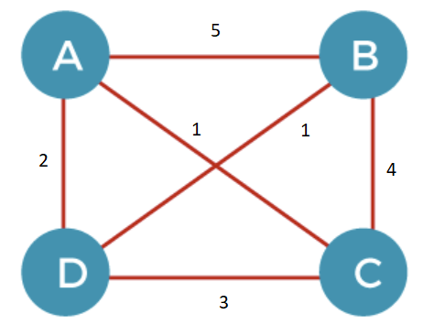
Minimum Spanning Tree
Before knowing about the minimum spanning tree, we should know about the spanning tree.
To understand the concept of spanning tree, consider the below graph:
This graph can be represented as G(V, E), where 'V' is the number of vertices, and 'E' is the number of edges.
The number on top of the edges represents the weight of the edge.

Slide 3
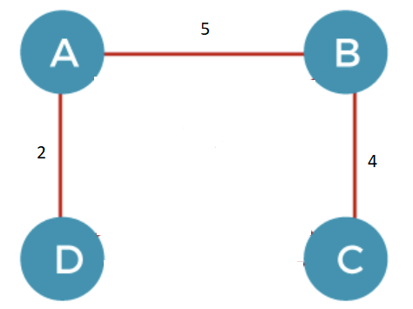
Spanning Tree
Given an undirected and connected graph G(V, E), such as before, a spanning tree of the graph is a tree that spans (that is, it includes every vertex of G) and is a subgraph of G (every edge in the tree belongs to G ).
The spanning tree of a graph would be represented as G`(V`, E`).
This is one of the spanning trees of the given graph.
Conditions of a Spanning Tree

Slide 4
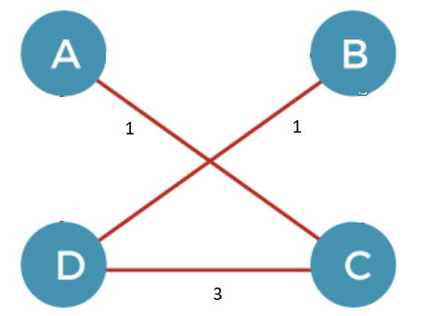
What is a Minimum Spanning Tree?
The cost of the spanning tree is the sum of the weights of all the edges in the tree. There can be many spanning trees. Minimum spanning tree is the spanning tree where the cost is minimum among all the spanning trees.
This is the minimal spanning tree of the given graph.
The cost of this spanning tree is only 5, which is the minimum cost. (whereas the cost of the previous spanning tree was 11!)
General Properties of a Minimal Spanning Tree

Slide 5
Minimum Spanning Tree Algorithms
From a given graph, we can get the minimum spanning tree using a few algorithms namely,
1)Borukva’s algorithm
2)Kruskal’s algorithm
3)Prim’s algorithm

Slide 6
Consider N houses in a colony and these houses are to be linked using a tele-communication network for cable connection & laying of communication links between any two houses involves cost which depends on the distance between the two houses and cost of building the connection.

Slide 7
GOAL
To find a cable connection between the houses, involving all the houses in minimum cost.

Slide 8
EXAMPLE

Slide 9
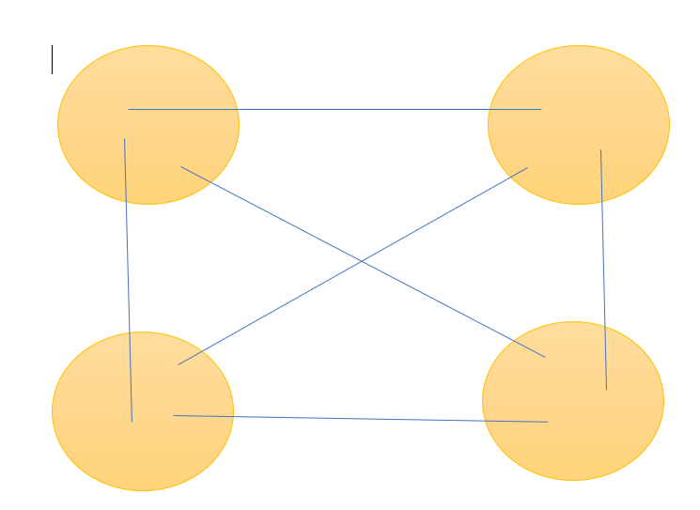
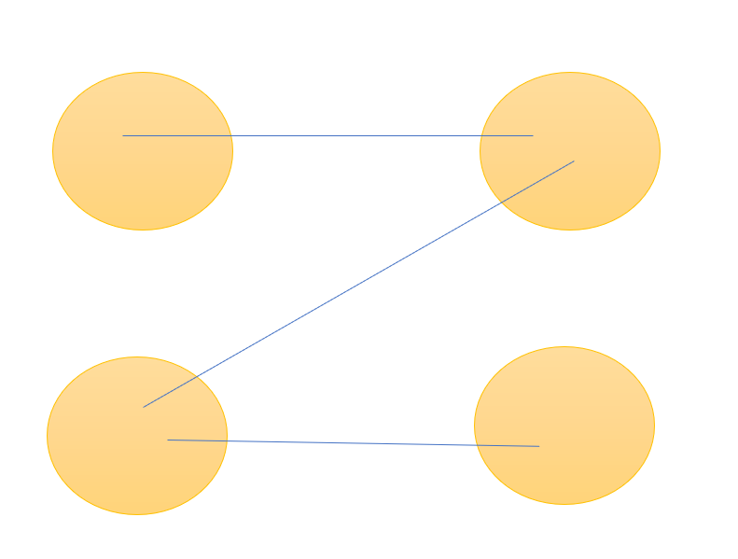
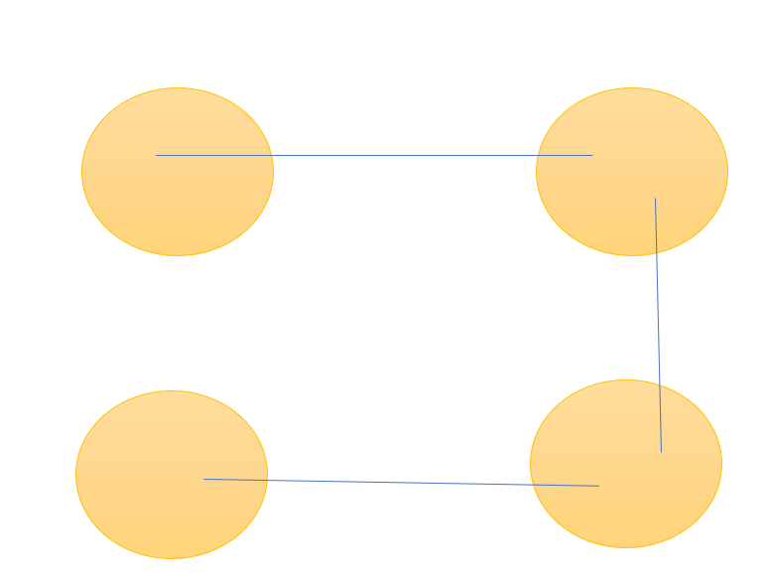
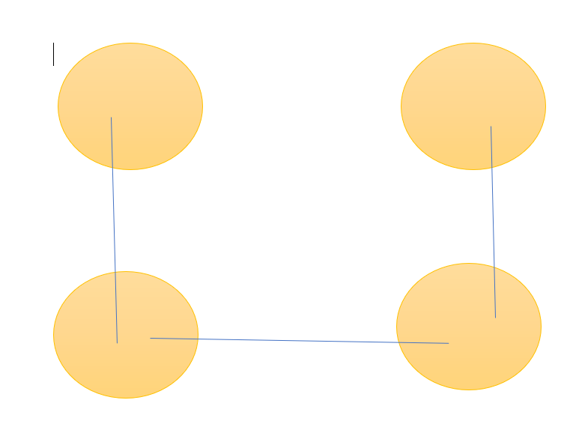
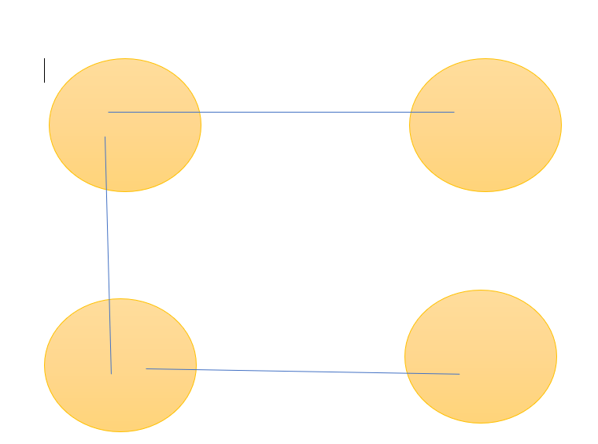
A
B
C
D
And so on.. (i.e) 4^(4-2)=16 spanning trees

Slide 10
From the above given example, when the distance between the houses (as edge weights) is given, we are supposed to find the minimum spanning tree in such a way that the total distance between the houses is minimum as that is directly proportional to the cost of building the cable connection since the cable cost depends on the distance.

Slide 11
NOW, LET’S TAKE A LOOK AT THE IMPLEMENTATION

